Slide 1


IoT-Based Mountain Climbing Health & GPS Tracker

Slide 2

CONTENTS
1. About the Project
2. Aim
3. Problem Statement
4. Research
5. Tentative Objectives
6. Scope

Slide 3

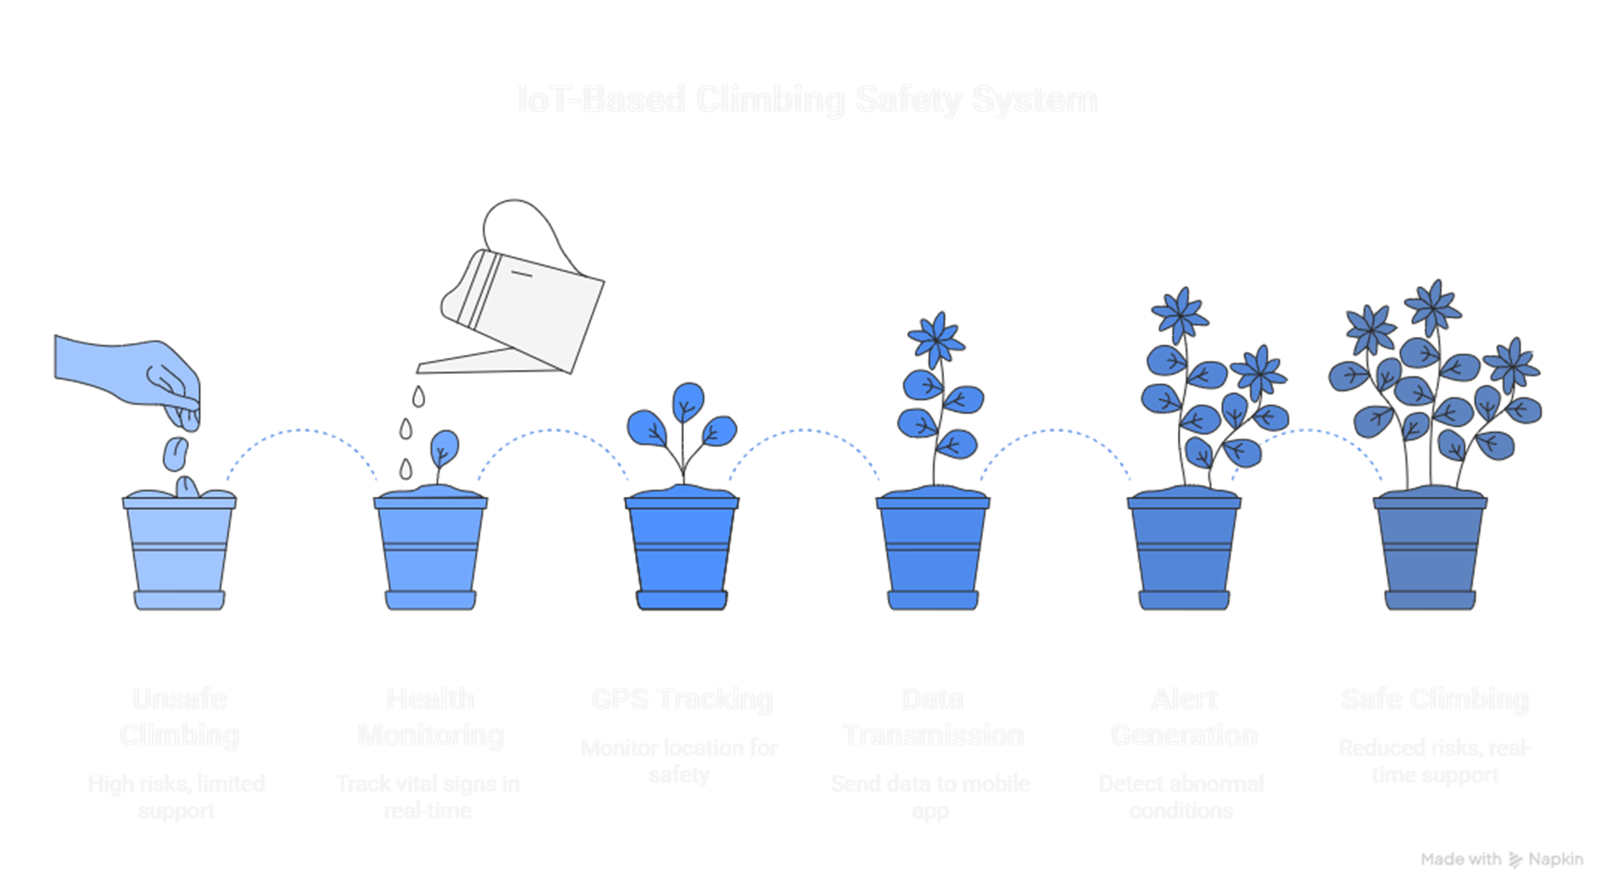
01
About the
Project

Slide 4
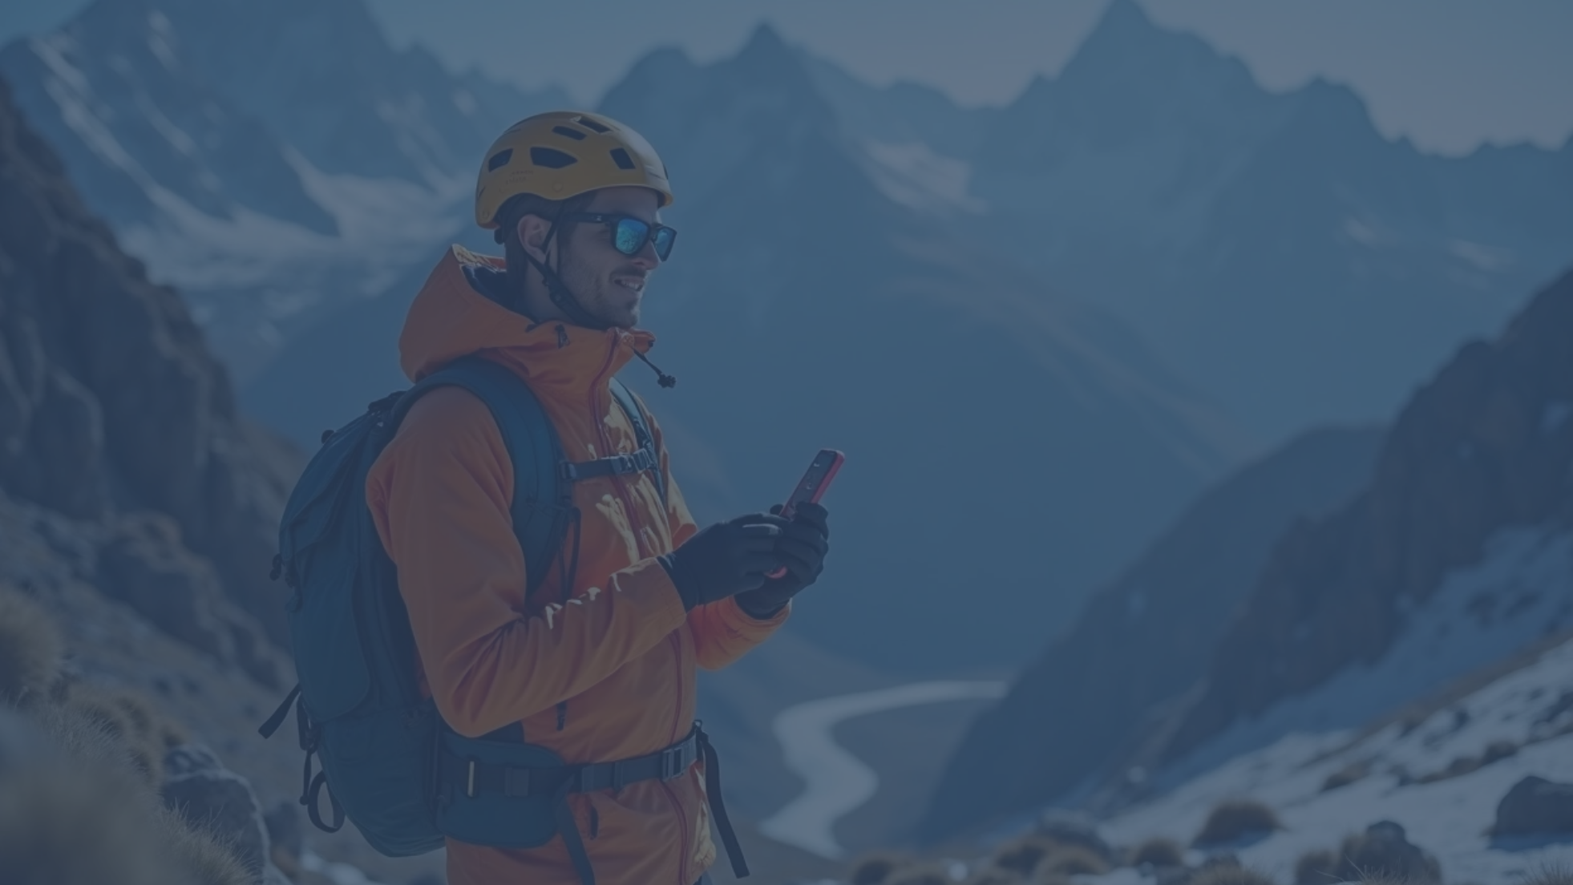
This project focuses on a smart, affordable IoT solution for climbers, integrating health monitoring and
GPS tracking into one system.
Mountaineering and trekking are adventurous activities but carry significant risks, especially in remote and high-altitude regions like the Himalayas. Climbers often face altitude sickness, exhaustion, hypothermia, dehydration, and navigation issues. In India, these challenges are even more severe due to limited infrastructure, poor mobile connectivity, and high rescue response times.
To address these challenges, this project proposes a low-cost IoT-based system that combines health monitoring (heart rate, SpO₂, temperature) and GPS tracking. The system uses commonly available components like ESP32 microcontroller, MAX30102 sensor, DS18B20 temperature sensor, and GPS module. Data is transmitted to a mobile application (Blynk) for real-time display. Alerts are generated when abnormal conditions are detected, such as low oxygen levels or high body temperature.
This project is designed to be affordable, easy to build, and suitable for students as a semester project while still addressing real-world challenges faced by climbers.

Slide 5

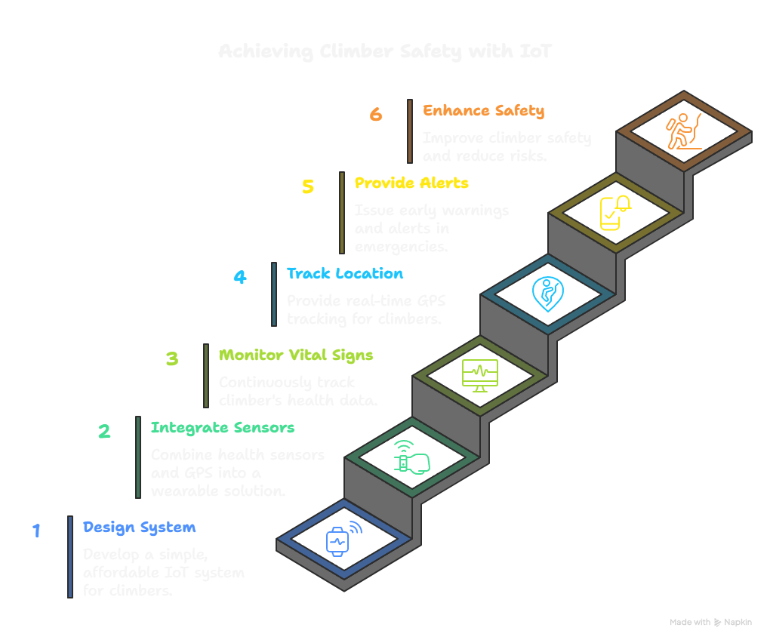
02
Aim

Slide 6

Aim
The aim of this project is to design and implement a simple, affordable IoT system that continuously monitors a climber’s vital signs and real-time location, while providing early warnings and alerts in case of emergencies.
By integrating health sensors and GPS into one wearable solution, the project seeks to enhance safety, reduce risks, and provide peace of mind for climbers, trekkers, and even students on field expeditions.

Slide 7

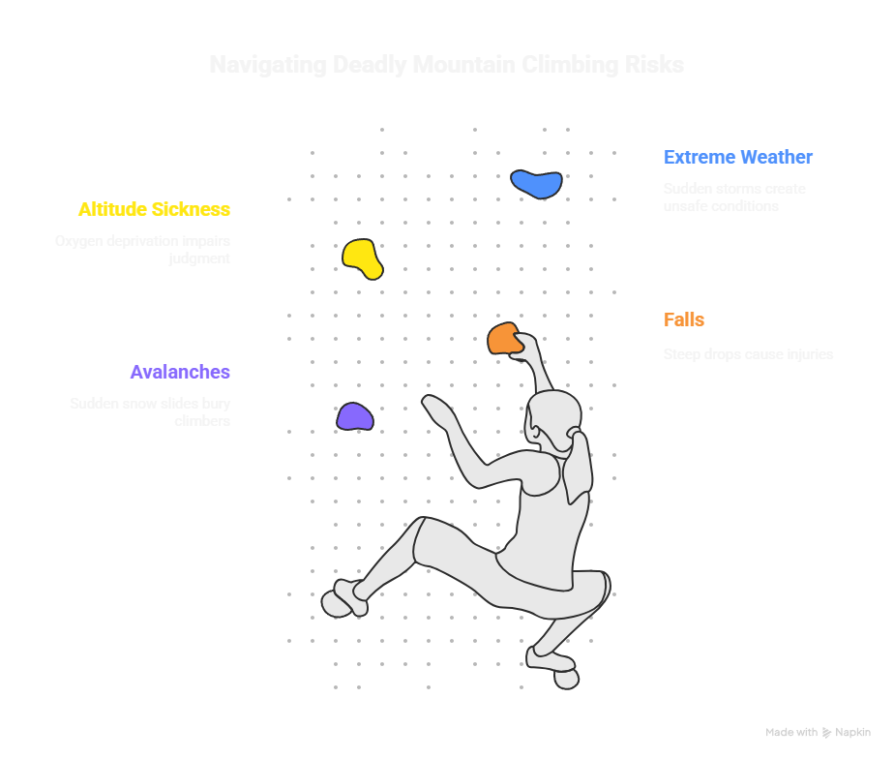
03
Problem Statement

Slide 8


Problem Statement
Mountain climbers and trekkers often encounter life-threatening risks, including:
Sudden health issues: altitude sickness, hypothermia, dehydration, exhaustion, and low oxygen levels.
Disorientation: losing path in difficult terrain.
Communication gaps: poor network connectivity in remote areas delays emergency alerts.
Rescue delays: absence of real-time health and location information reduces rescue efficiency.
Traditional methods like walkie-talkies, manual health checks, or mobile phones are inadequate in such conditions. International climbers often use expensive devices like Garmin InReach or SPOT trackers, but these cost ₹25,000–₹60,000, making them inaccessible to most Indian climbers and students.
There is no affordable, integrated system for Indian climbers that provides real-time health monitoring, GPS tracking, and emergency alerts in one solution.
This project addresses this gap with a student-friendly IoT prototype, designed to be cost-effective, reliable, and easy to demonstrate.

Slide 9
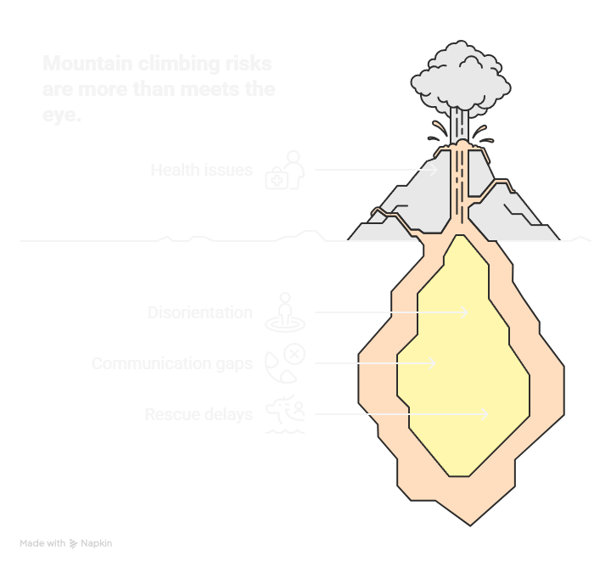

Slide 10


04
Research

Slide 11
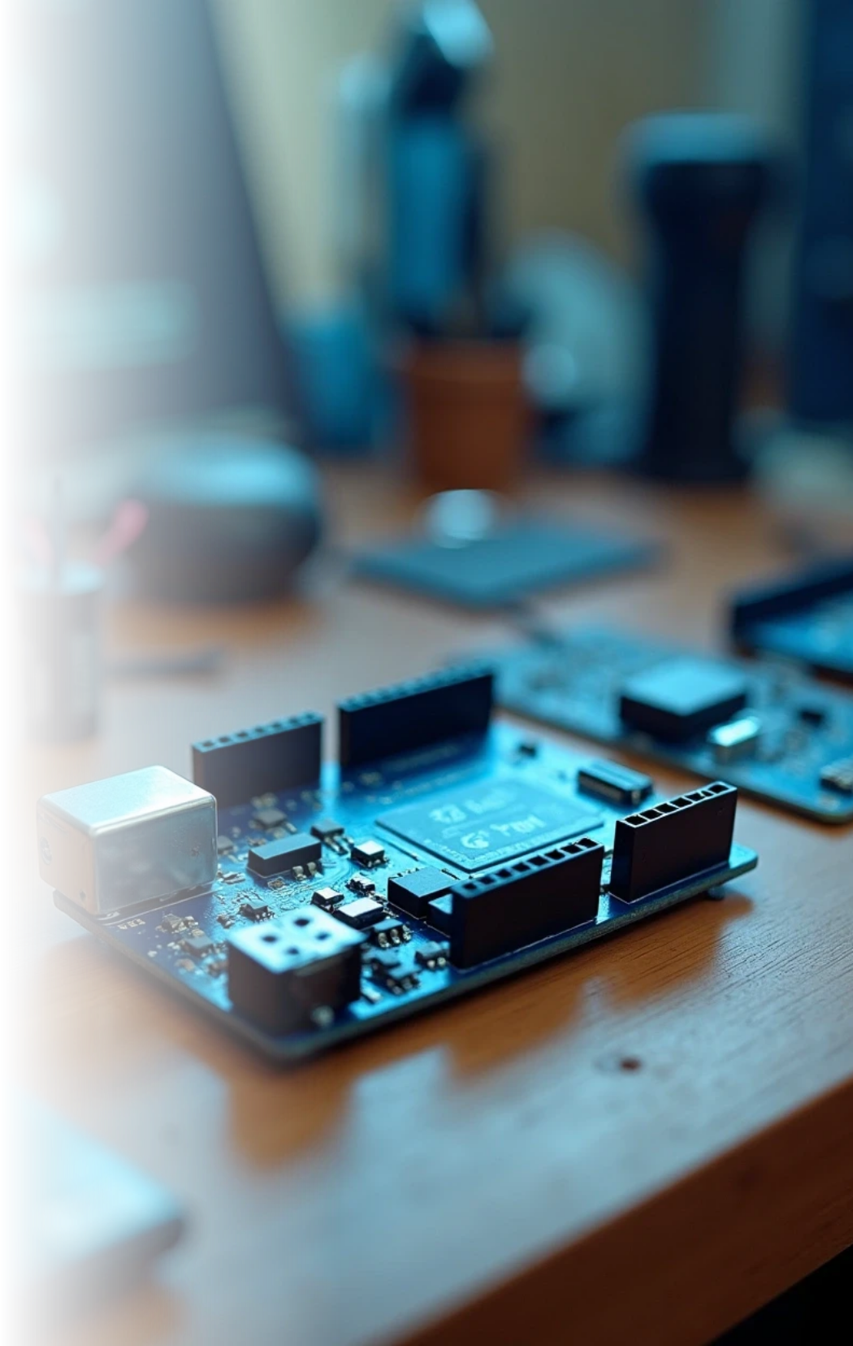
Existing Work
Past studies have used Arduino/ESP32 microcontrollers with temperature and heart rate sensors to monitor patient health remotely. Some prototypes added GPS and GSM modules to track location and send alerts.
The uploaded research paper from Malaysia (2025) achieved 96% accuracy in vital monitoring but faced challenges like battery life, GPS accuracy, and ruggedness.

Slide 12
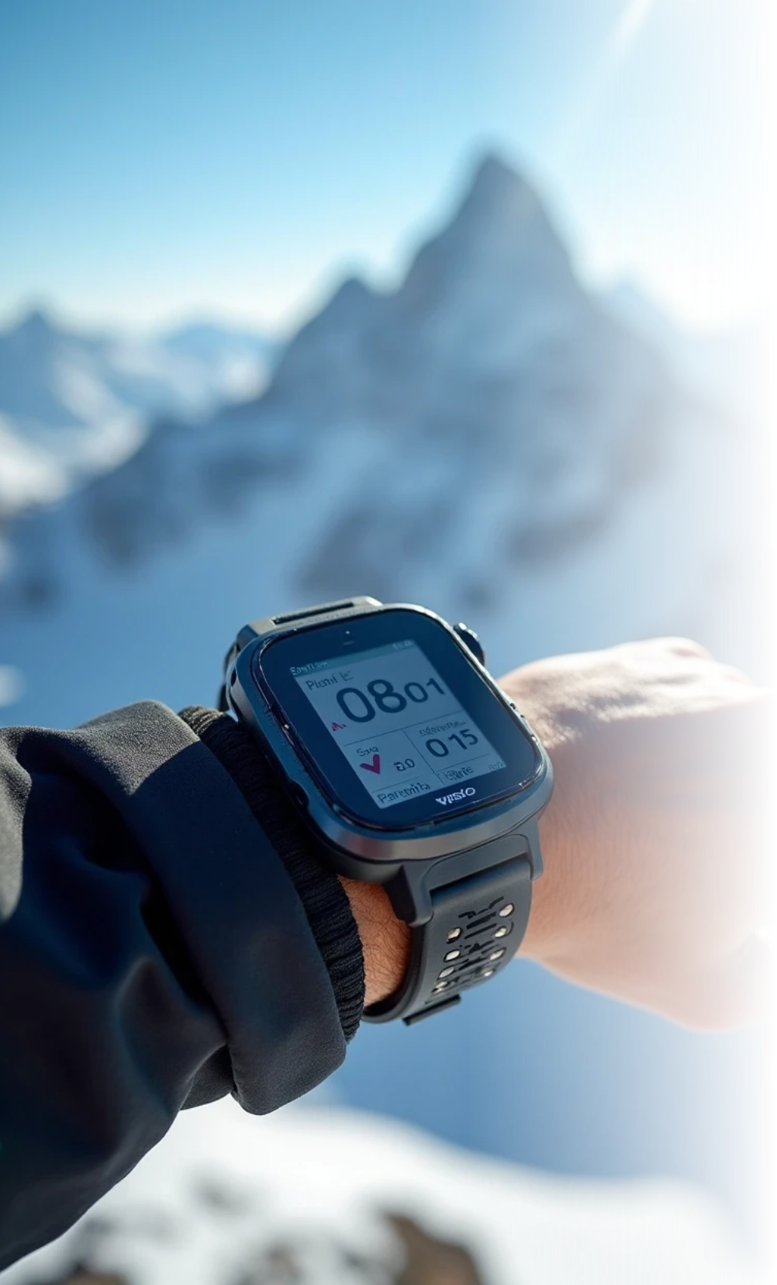





Limitations in Current Solutions
1
Most systems monitor only temperature and heart rate, not SpO₂ (oxygen), which is crucial in high altitudes.
2
Devices usually last only 8–10 hours, while treks in India often last several days.
3
Connectivity is limited; GSM fails in valleys, and LoRa requires expensive gateways.
4
Prototypes are often fragile and not affordable for real-world Indian users.

Slide 13
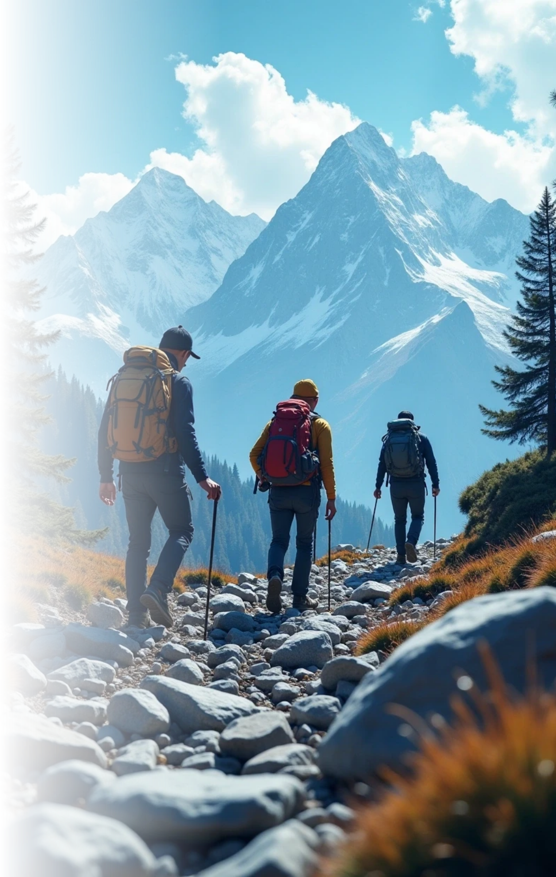
Indian Context
Climbers in the Himalayas, trekkers in Himachal and Uttarakhand, and pilgrims at Amarnath, Kedarnath, and Hemkund Sahib face serious risks.
Rescue operations are slow, infrastructure is poor, and budget trekkers cannot afford international safety trackers. Hence, the demand is for a low-cost, easy-to-use IoT system that students can build and climbers can afford.

Slide 14
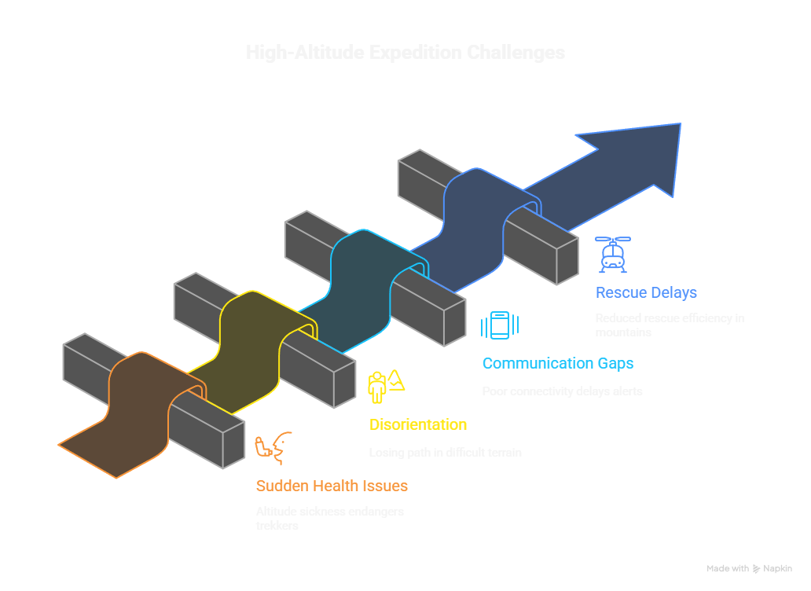

Slide 15


05
Tentative Objectives

Slide 16
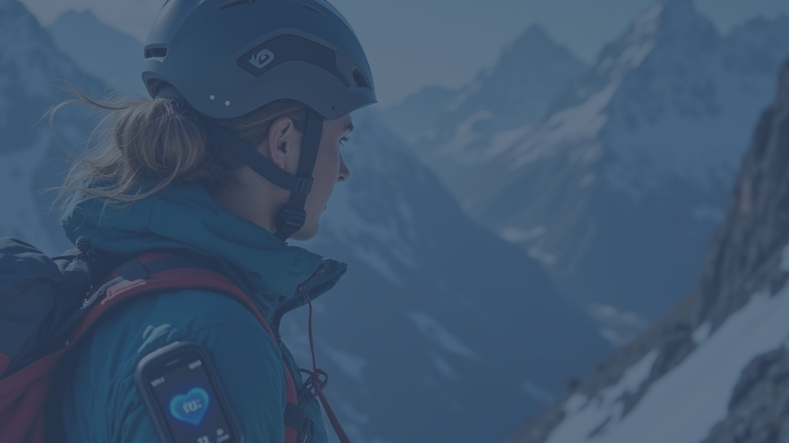

Health Monitoring: Measure heart rate, SpO₂, and body temperature in real time.
GPS Tracking: Continuously track and log climber’s location; sync data when network returns.
Alerts & Emergency System: SOS button for emergencies; automatic alert when vitals cross danger thresholds.
Connectivity Solutions: Use ESP32 Wi-Fi + GSM for simple, affordable alerts; optional Bluetooth app connection for nearby monitoring.
User Interface: Display real-time vitals and location in the Blynk mobile app; send alert notifications instantly.
Low-Cost & Low Power Design: Use low-power sensors and rechargeable battery; target cost under ₹2,500 for affordability.

Slide 17
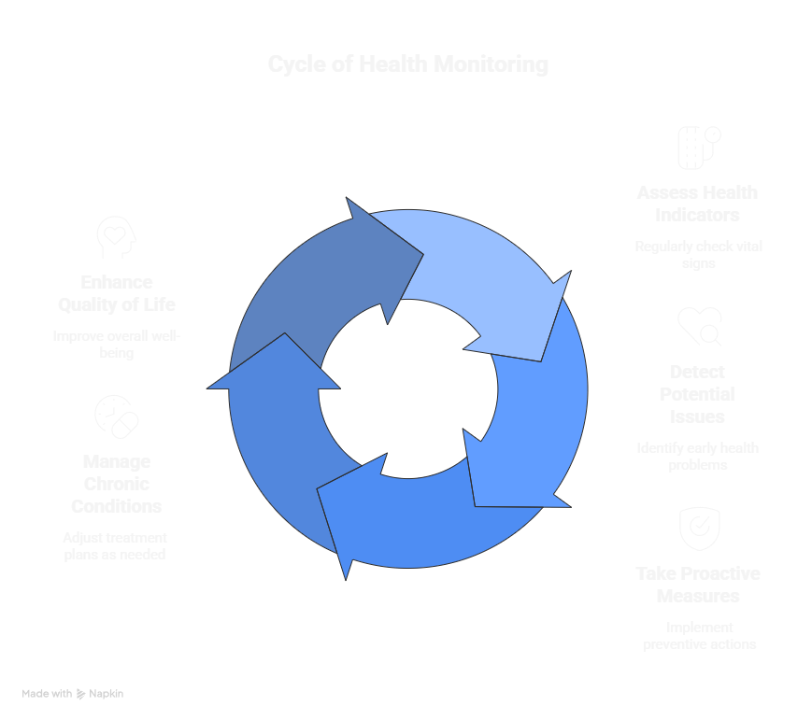
Health Monitoring: Measure heart rate, SpO₂, and body temperature in real time.

Slide 18
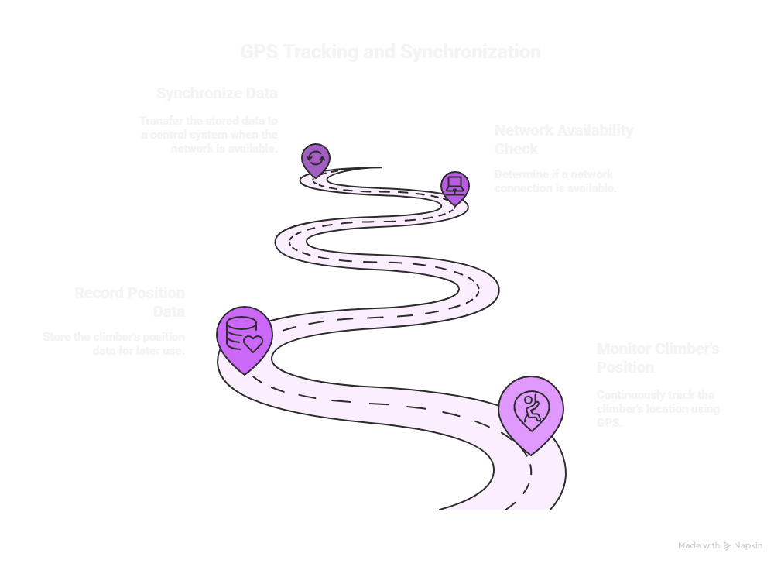
GPS Tracking: Continuously track and log climber’s location; sync data when network returns.

Slide 19
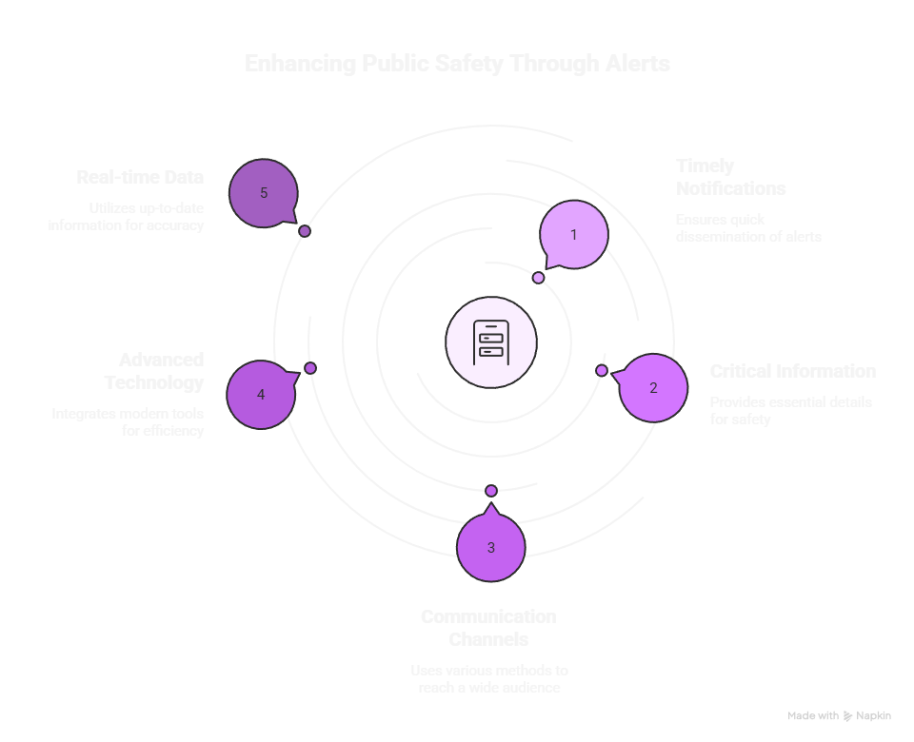
Alerts & Emergency System: SOS button for emergencies; automatic alert when vitals cross danger thresholds.

Slide 20
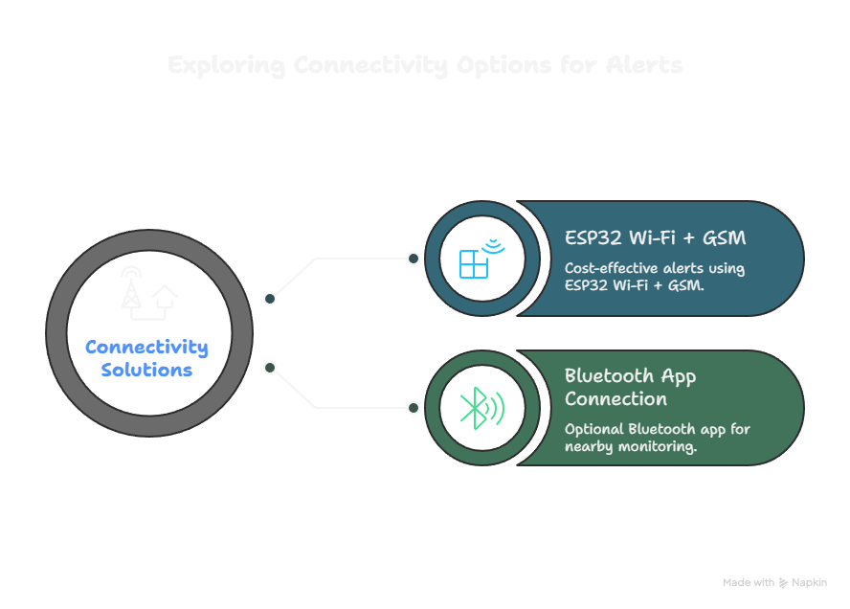
Connectivity Solutions: Use ESP32 Wi-Fi + GSM for simple, affordable alerts; optional Bluetooth app connection for nearby monitoring.

Slide 21
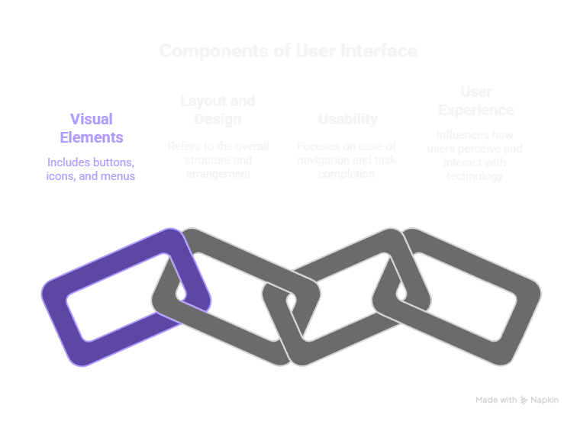
User Interface: Display real-time vitals and location in the Blynk mobile app; send alert notifications instantly.

Slide 22
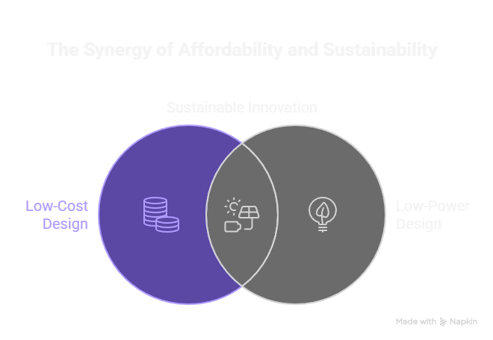
Low-Cost & Low Power Design: Use low-power sensors and rechargeable battery; target cost under ₹2,500 for affordability.

Slide 23
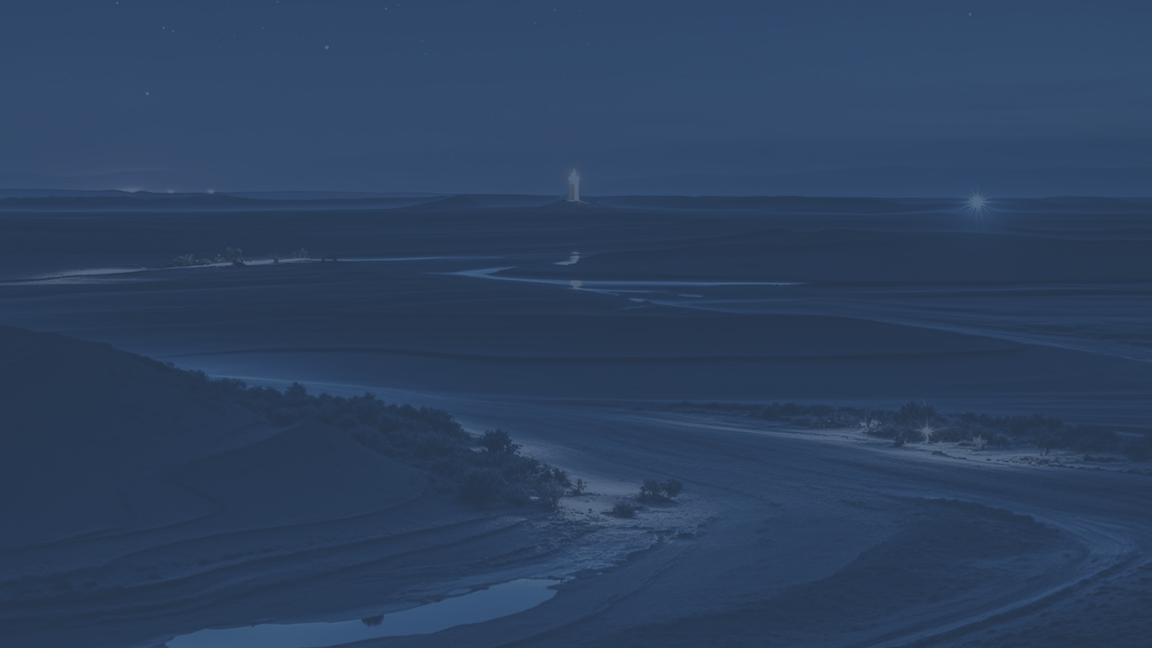
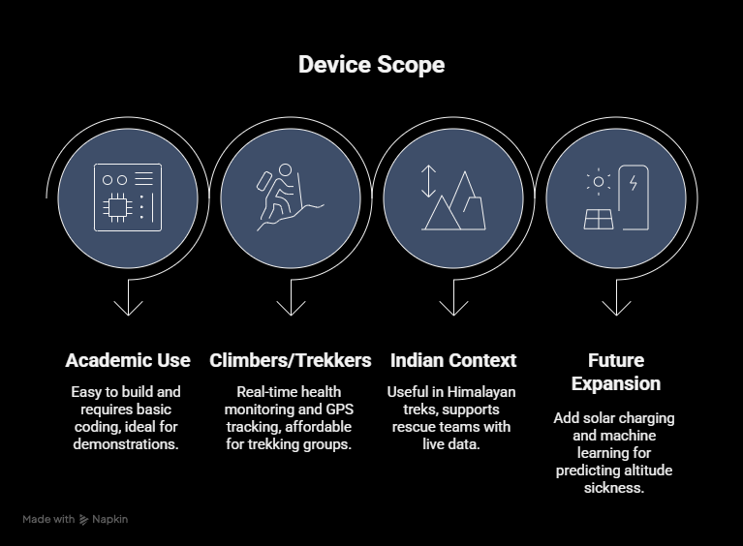
06
Scope

Slide 24
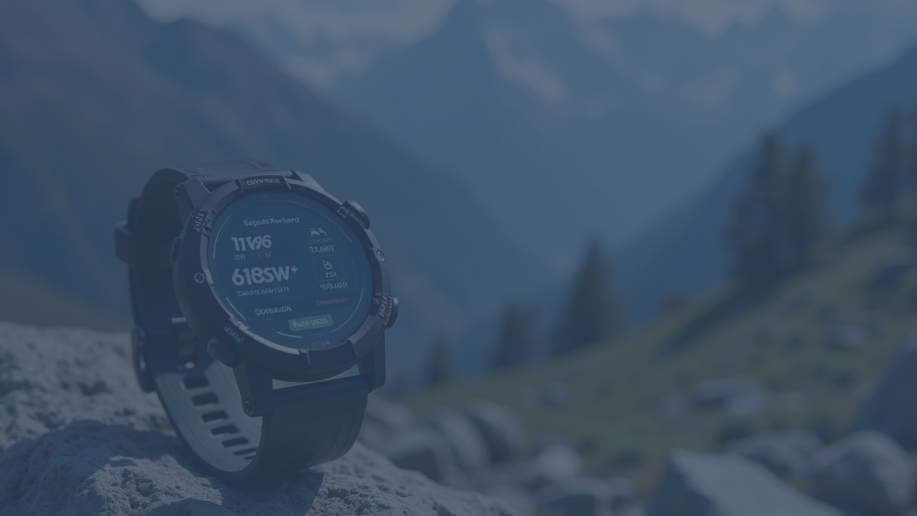


Scope
For Students (Academic Use)
For Climbers and Trekkers
• Easy to build with readily available modules.
• Provides real-time health monitoring and GPS tracking.
• Requires only basic Arduino/ESP32 coding.
• Affordable compared to international devices.
• Ideal for semester exams and lab demonstrations.
• Helpful for trekking groups, NCC cadets, and students.
For Indian Context
Future Expansion
• Useful in Himalayan treks, yatras, and expeditions.
• Add solar charging for multi-day expeditions.
• Can support rescue teams by providing live health and location data.
• Integrate machine learning to predict altitude sickness.
• Rugged, waterproof wearable design for commercial use.
• Reduces risks in areas with poor connectivity.
• Centralized dashboard for rescue teams (SDRF, NDRF, IMF, NIMAS).

Slide 25

Thank You
Project Work by: Anshu (2420669) Anshu Mukati (2420670) Anuj Chauhan (2420671) Anushka Jaglan (2420672)
Guided by: Er. Shubham Sharma J4224
Assistant Professor

